Slide 1
Application of Data Analysis Technology in Sports Prediction
数据挖掘课程论文阅读
2017213854 赵越
2017213867 陈元亮
2017213852 傅滢

Slide 2
Paper 1
Goals: To predict Who will score next? and Who will win? in a game
Models: Based on specific underlying mechanisms for sports scoring dynamics, generate 4 skill-based probabilistic models: (i) independent, (ii) restorative, (iii) independent anti-persistent, and (iv) restorative anti-persistent models
Data set: From four team sports: college-level American football (CFB, 10 seasons; 2000-2009), professional American football (NFL, 10 seasons; 2000-2009), hockey (NHL, 9 seasons; 2000-2003, 2005-2009) and basketball (NBA, 9 seasons; 2002-2010)
Peel L, Clauset A. Predicting Sports Scoring Dynamics with Restoration and Anti-Persistence[C]// IEEE International Conference on Data Mining. IEEE Computer Society, 2015:339-348.
Notes:
For each, we assess model goodness-of-fit by calculating the held out likelihood for each model under a 10-fold cross validation.

Slide 3
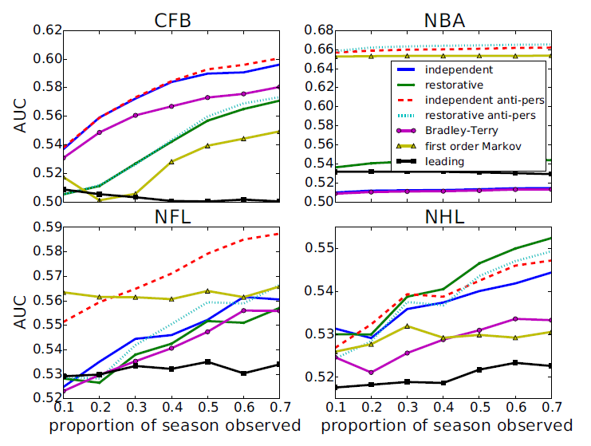
Paper 1
Result 1:
Probability of accurately predicting which team will score next (AUC)
Peel L, Clauset A. Predicting Sports Scoring Dynamics with Restoration and Anti-Persistence[C]// IEEE International Conference on Data Mining. IEEE Computer Society, 2015:339-348.
Notes:
3 baseline models: naive leading model, standard Bradley-Terry model, simple first order Markov model
Based on 95% confidence intervals, our best model performs significantly better than the baseline models for CFB and NBA, and after observing at least half of the season for NFL and NHL.

Slide 4
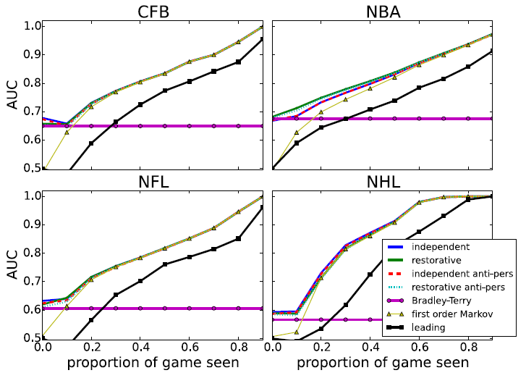
Paper 1
Result 2:
AUC scores for predicting which team will win given the current state of the game
Peel L, Clauset A. Predicting Sports Scoring Dynamics with Restoration and Anti-Persistence[C]// IEEE International Conference on Data Mining. IEEE Computer Society, 2015:339-348.
Notes:
The relatively poorer performance of the “leading” baseline model illustrates that this prediction task is non-trivial—who is leading at a given moment is not as predictive of who wins as knowing something about team skills and scoring
dynamics.
For this task, most of our skill-based models make very similar predictions and the first order Markov model also
performs well. In particular, the first order Markov model performs much worse than the skill-based models at the beginning because it has no information about the heterogeneity of team scoring abilities.

Slide 5
Paper 2
Goals: Simulate the basketball match between two distinct teams as a sequence of team-level play-by-play in-game events
Methodology: Assume the Markov property and model state transitions with a Logistic regression model, extend the model state description to capture the current context in the progression of a game
Data set: Used play-by-play data from 3 regular NBA seasons(seasons 2008/09 to 2010/11)
Extension: The methodology facilitates simple inclusion into any expert system and decision-making process that requires the performance evaluation of teams under various scenarios
Petar Vracar, Erik Štrumbelj, and Igor Kononenko. 2016. Modeling basketball play-by-play data. Expert Systems with Applications 44 (2016), 58 – 66.
Notes:
Using a random walk through a state space whose states represent the in-game events of interest. The main idea of our approach is to extend the state description to capture the current context in the progression of a game. Apart from the in-game event label, the extended state description also includes game time, the points difference, and the opposing teams ‘characteristics. By doing so, the model’s transition probabilities become conditional on a broader game context (and not solely on the current in-game event), which brings several advantages: it provides a means to infer the teams ‘specific behavior in relation to their characteristics, and to mitigate the intrinsic non-homogeneity of the progression of a basketball game (which is especially evident near the end of the game). To simplify the modeling of the transition distribution, we factorize it into terms that can be estimated with separate models.
deal with non-homogeneity of the progression of a basketball game by incorporating relevant variables(time,point difference,…) into the state space of the model.

Slide 6
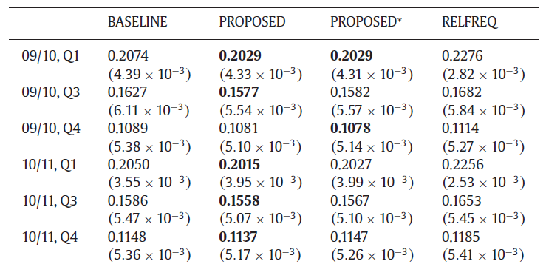
Paper 2
Result :
PROPOSED model is the best forecaster(The best model is shown in bold )
Petar Vracar, Erik Štrumbelj, and Igor Kononenko. 2016. Modeling basketball play-by-play data. Expert Systems with Applications 44 (2016), 58 – 66.
Notes:
We learned all models using the games from one season and evaluated them with respect to how well they can predict the winners of the games in the following season.
Mean Brier score (with standard error in parentheses) for the home team’s win probability forecasts, measured on 2009/10 and 2010/11 NBA regular seasons, starting from the beginning of the game(Q1), from the actual result at the half-time(Q3), and from the actual result at the start of the fourth quarter(Q4). The best model is shown in bold (N = 1190).
PROPOSED model is the best forecaster

Slide 7

Sports are extremely surprising
Unpredictability cannot be avoided
$$Φ=\frac{S^{2}−σ_{2k}^{2}}{S^{2}}$$
Range:$\left(−∞,1\right]$
Measures the discrepancy between
the random model variance and the
observed variance
Skill
Luck
Notes:
这篇论文也是讲技能和运气这2个因素对比赛结果的影响,相比于前2篇文章,本文突出的地方在于加入了运气因素用来预测比赛结果,加入运气因素的原因在于体育比赛的不确定性因素难以避免.运气用$Φ$符号表示,公式如….,系数的范围是负无穷大到1,用于衡量随机比赛模型和实际比赛模型观察值的差异.[解释S的含义,\sigma的含义,公式计算的过程\含义]

Slide 8
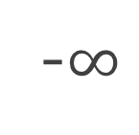
A luck and skill coefficient
-$∞$
0
1
Atypical
Luck
Skill
Close to 1: skill factor has more influence
Close to 0: skill factor has a small influence in the results
Notes:
这张图直观的展示了$Φ$的不同取值的含义, $Φ$的值接近1表示技能因素影响比赛结果的程度最高, $Φ$的值接近0表示运气因素影响比赛结果的程度最高,从公式看S平方接近于正态分布\sigma^2,比赛的结果完全随机.
Negative values: observed variance is LESS than the expected value under the random model
Monte Carlo simulation considering true the random model hypothesis

Slide 9
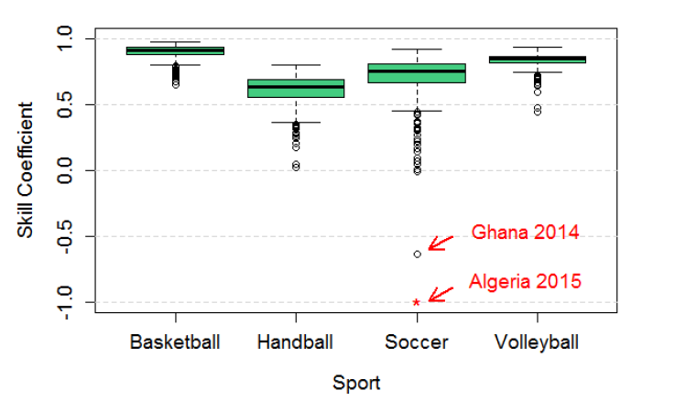
Some results with Ф Coefficient
Notes:
越接近上限1，越接近随机模型，更重要的是解释最终得分的技能组件。 篮球是最后一项成绩最大的运动。 第二个是排球，第三个是足球，第四个是手球。

Slide 10
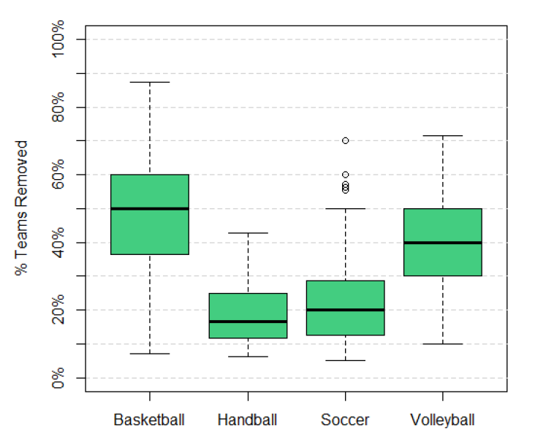
How many teams should be removed to make it random?

Slide 11
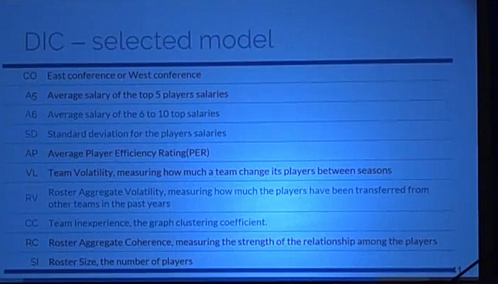
DCI-selected model

Slide 12
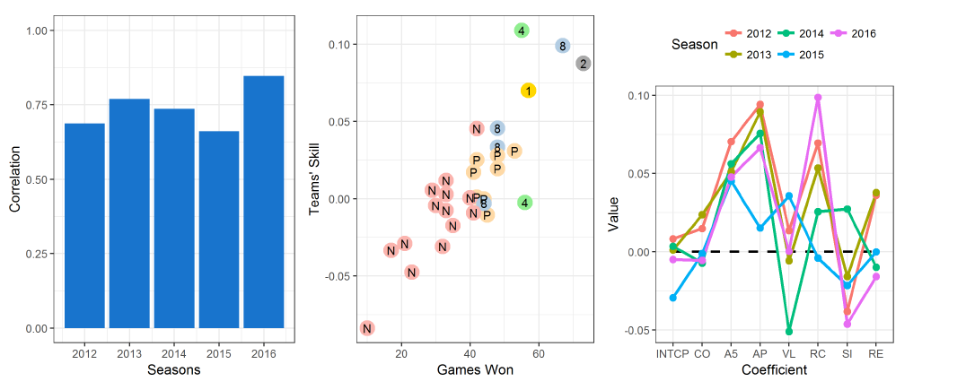

Slide 13
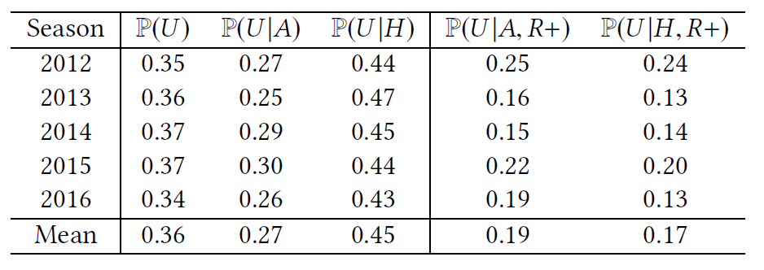
When the underdog plays at home, its winning probability increase 0.18
This effect disappears if playing against the best ones

Slide 14
Management strategy
Building smaller teams allow for higher salaries
It also increase the odds of attracting high PER players and increasing rapport(roster aggregate coherence)
Smaller, more cohesive teams have less conflicts and are easier to manage

Slide 15
Conclusion
Contribution
Ф coefficient
Which leagues and sports are more competitive
Bayesian model
Which features have more influence on the skill

Slide 16
Attractive area
Relatively isolated system seen repeatedly
Many datasets available
Popularity
Economic Relevance
Notes:
84个国家的1503个赛季的198个联赛4种不同的运动：篮球，足球，排球和手球

Slide 17
Related Work

Slide 18
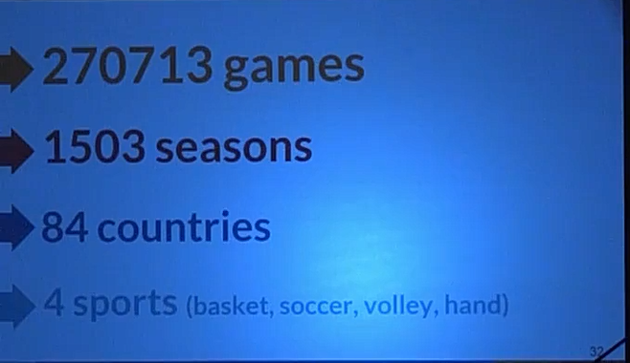

Slide 19
Goals & Methods
Evaluate the luck and skill influence in sports leagues
Skill influence -> Ф coefficicent
Significant test
Which teams should be removed to make a league random
Estimate the teams' skill
Teams' skill in a season/league
What explains skill?

Slide 20
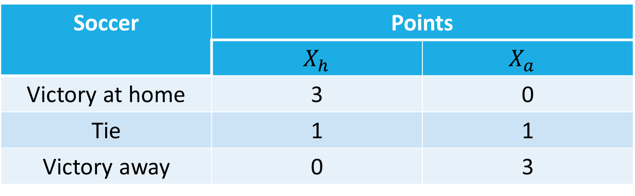
A luck and skill coefficient
For soccer:
Soccer | Points
 | $X_{h}$ | $$X_{a}$$
Victory at home | 3 | 0
Tie | 1 | 1
Victory away | 0 | 3

Slide 21
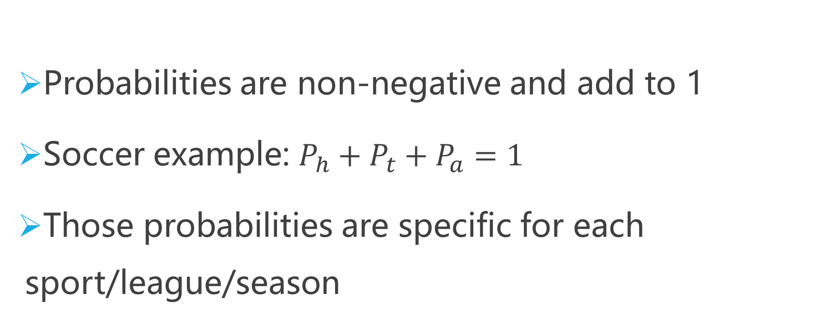
A luck and skill coefficient
Probabilities are non-negative and add to 1
Soccer example: $P_{h}+P_{t}+P_{a}=1$
Those probabilities are specific for each sport/league/season
Notes:
概率->期望->

Slide 22
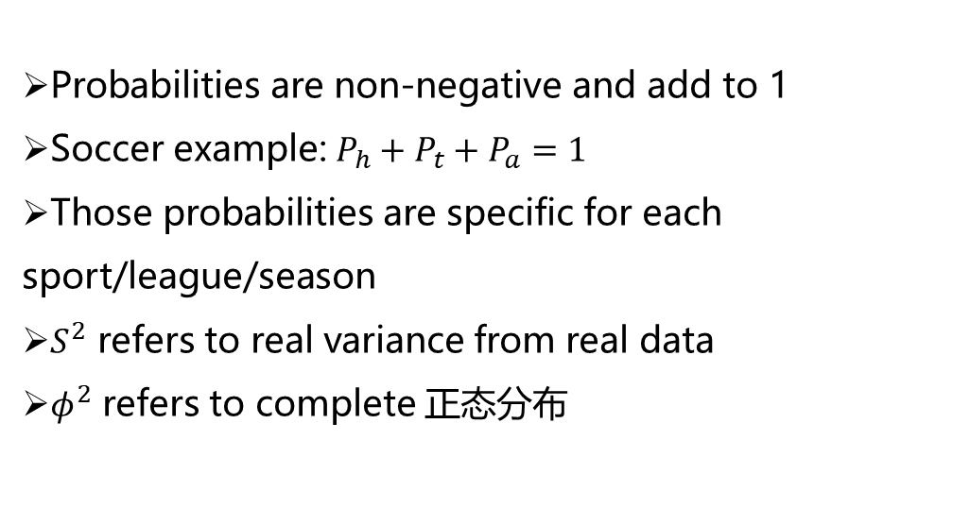
A luck and skill coefficient
Probabilities are non-negative and add to 1
Soccer example: $P_{h}+P_{t}+P_{a}=1$
Those probabilities are specific for each sport/league/season
$S^{2}$ refers to real variance from real data
$φ^{2}$ refers to complete 正态分布

Slide 23
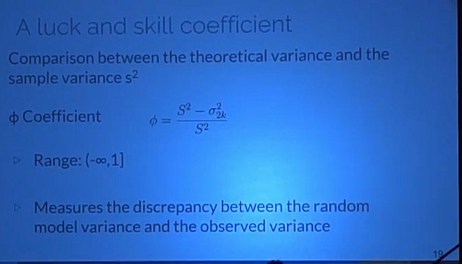
A luck and skill coefficient

Slide 24
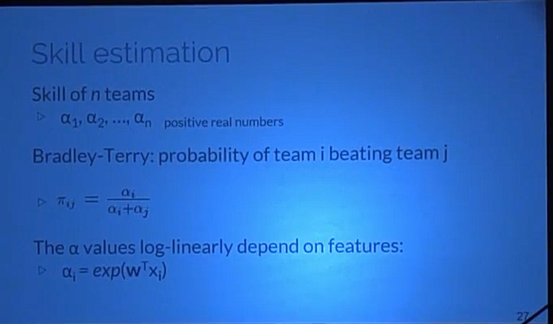
Skill estimation
Notes:
Skill estimation
Probabilities Graphical Model
Seasons/Leagues with significantly different of 0 and positive
Skill component is decomposed into explanatory features
Only basketball, NBA

Slide 25
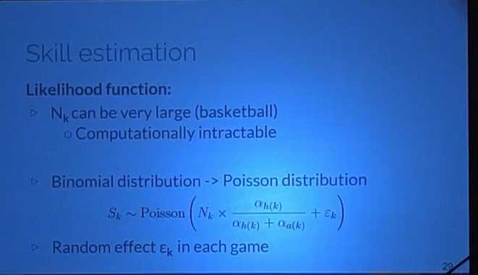
Skill estimation
Likelihood function:
Notes:
Likelihood function:
Games final score
K games and $n$ teams
$N_{k }$: total points of each team
$S_{k}$: points of the home team
$N_{k }$is a sequence of success and failures
$S_{k }$~ Binomial Distribution conditioned in $N_{k }$

Slide 26
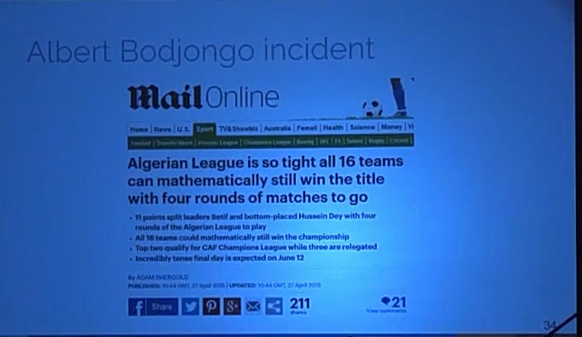
Albert Bodjongo incident

Slide 27
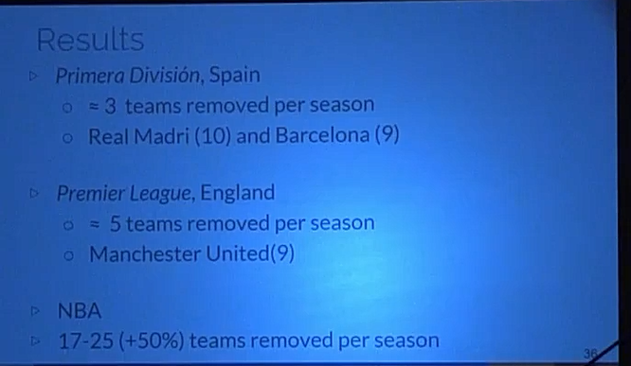
Results

Slide 28
Skill estimation
Probabilities Graphical Model
Seasons/Leagues with significantly different of 0 and positive
Skill component is decomposed into explanatory features
Only basketball, NBA

Slide 29
Dados
League
National Basketball Association(NBA)
Regular Season: round-robin system(=1230 matches)
Playoffs: 16 teams

Slide 30
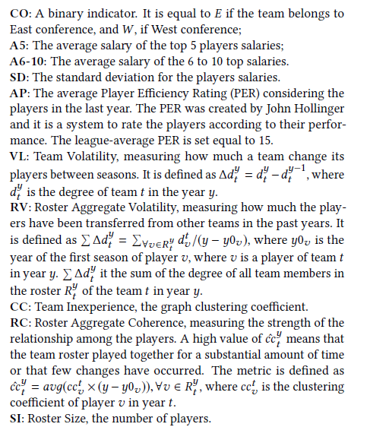
Features

Slide 31


Skill estimation
Likelihood function:
Games final score
K games and $n$ teams
$N_{k }$: total points of each team
$S_{k}$: points of the home team
$N_{k }$is a sequence of success and failures
$S_{k }$~ Binomial Distribution conditioned in $N_{k }$

Slide 32
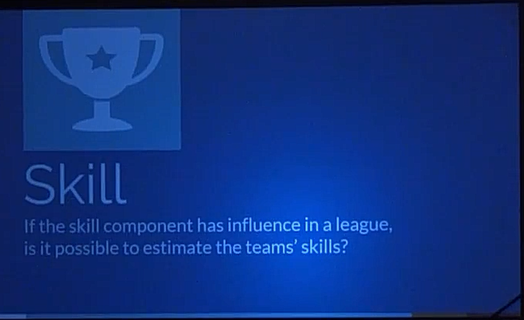

Slide 33
Results
Ф Coefficient

Slide 34
A luck and skill coefficient
-$∞$
0
1
Atypical
Luck
Skill
Close to 0: skill factor has a small influence in the results

Slide 35
A luck and skill coefficient
-$∞$
0
1
Atypical
Luck
Skill
Negative values: observed variance is LESS than the expected value under the random model

Slide 36

A luck and skill coefficient
Confidence interval(95%) around 0
-$∞$
0
1
Atypical
Luck
Skill
Monte Carlo simulation considering true the random model hypothesis

Slide 37
A luck and skill coefficient
If Ф is significantly different from 0,
how many teams should be removed from a league in order to turn it random?
By repeated simulation

Slide 38
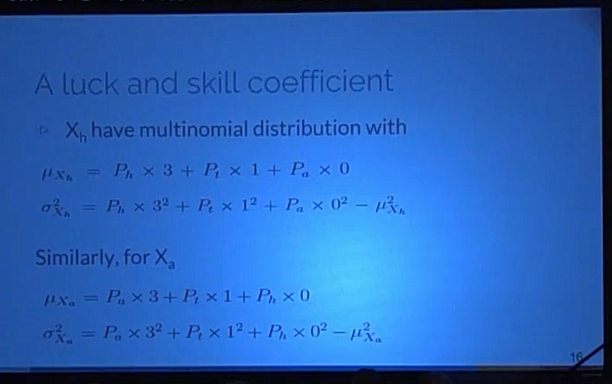
A luck and skill coefficient

Slide 39
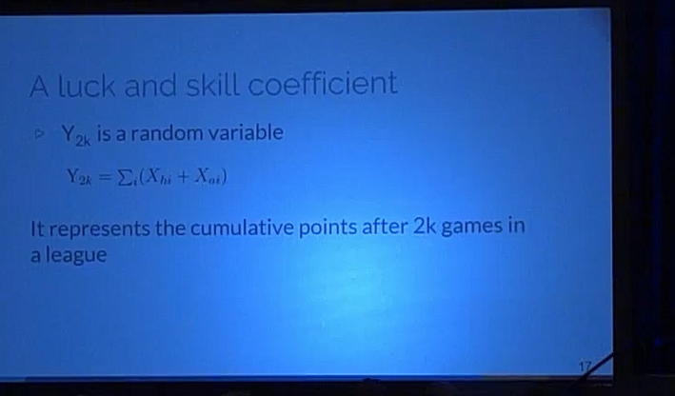
A luck and skill coefficient

Slide 40
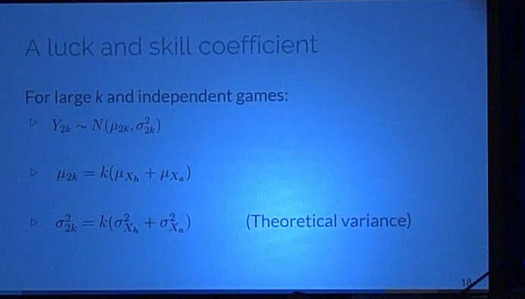
A luck and skill coefficient

Slide 41
Disentangling luck and skill

Slide 42
A luck and skill coefficient
Leagues considered
Teams with the same number of games
Each team plays twice against all others, once at home
The final result is total number of points accumulated
Contextual factors allowed(home advantage only)

Slide 43
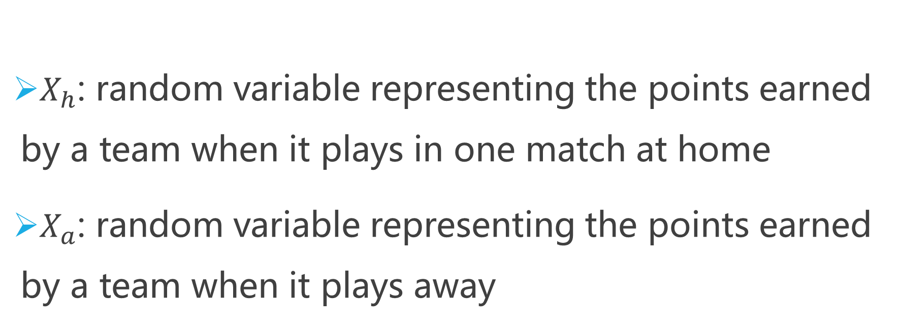
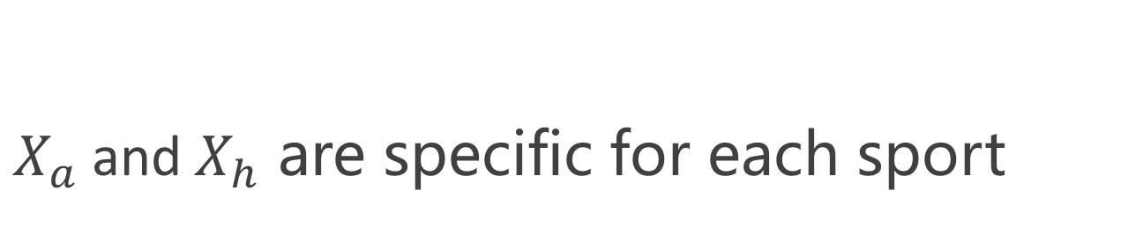
A luck and skill coefficient
$X_{h}$: random variable representing the points earned by a team when it plays in one match at home
$X_{a}$: random variable representing the points earned by a team when it plays away
$X_{a}$and$X_{h}$ are specific for each sport

